Slide 1
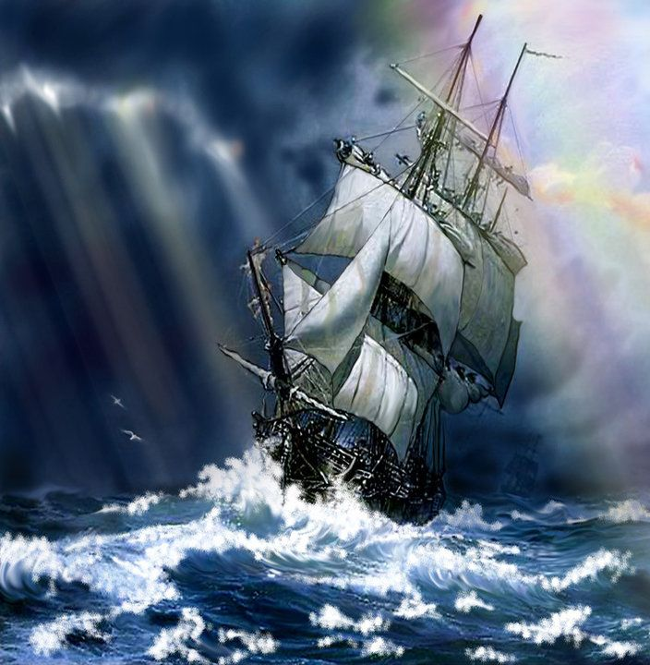
WE’RE NOT AFRAID TO DIE ….
IF WE CAN ALL BE TOGETHER
MODULE-1 of 2
By
GORDON COOK
&
ALAN EAST

Slide 2

Gordon Cook’s Desire
Gordon Cook wanted to sail in his own boat and duplicate the round the world voyage made 200 years earlier by Captain James Cook.

Slide 3
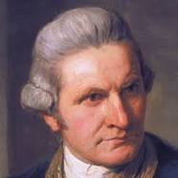
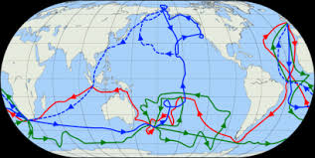
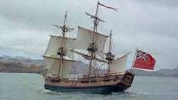
CAPTAIN JAMES COOK
Captain James Cook (7 November 1728– 14 February 1779) was a British explorer, navigator, cartographer, and captain in the British Royal Navy.
WORD MEANINGS
cartographer- a person who draws or produces
maps.

Slide 4
The story is a first person account of the narrator, Gordon Cook

Slide 5
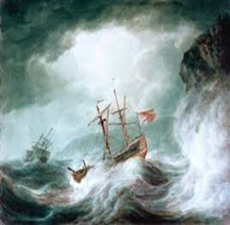
The story, ‘We’re Not afraid to Die-if We Can All Be Together’ is a story of extreme courage and skills exhibited by Gordon Cook, his family and crewmen in a war with water and waves, for survival.

Slide 6
The inspiring story teaches us
importance of endurance
impact of optimism in one’s life
Role of family
age is just a number
WORD MEANINGS
1. endurance- the capacity of something to last or to withstand wear and tear.

Slide 7
The narrator drives home the message that optimism, strong will power, grit, determination and the strong support of the family can help one come out of any disastrous situation with success and enriching experience.
WORD MEANINGS
1.Optimism- hopefulness and confidence about the future or the success of something.
2. Grit- courage and resolve; strength of character.
3. Disastrous- causing great damage
4. Enriching- improve or enhance the quality or value of

Slide 8

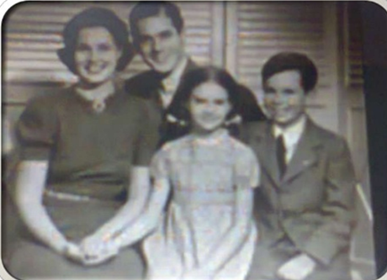
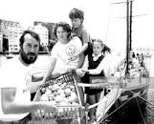
DRAMATIS PERSONAE
Gordon Cook: a 37 year old
            businessman
Mary: Cook’s Wife
Suzanne: Cook’s 7 year old daughter
Jonathan: Cook’s 6 year old son
Crewmen: a. Larry Vigil- American
        b. Herb Seigler- Swiss
        The boat: WAVE WALKER- 23metre, 30 ton

Slide 9

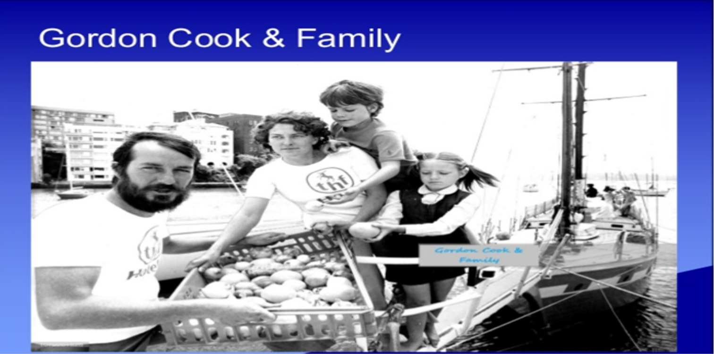
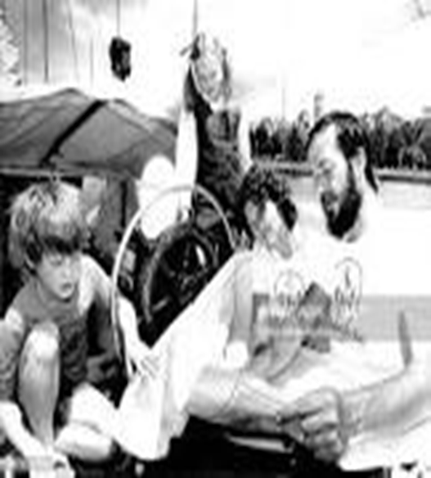
GORDON COOK & FAMILY

Slide 10
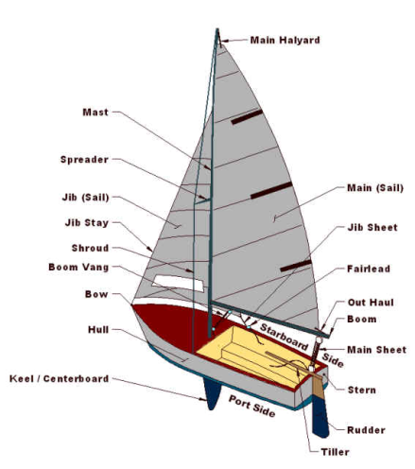
PARTS OF THE SHIP

Slide 11
Purpose of the Voyage
To duplicate the round-the-world voyage made 200 years earlier by Captain James Cook
WORD MEANINGS
Voyage- a long journey involving travel by sea or in space (here sea)
Duplicate- exactly like something else, especially through having been copied. (here repeat)

Slide 12
Preparations for the Voyage
For the past 16 years the narrator and his wife had been spending their leisure time honing their seafaring skills in British water.
They had arranged a professionally built boat- Wavewalker
The narrator and his wife had spent months fitting it out and testing it in the roughest weather they could find.
WORD MEANINGS
leisure- free time
Honing- refining or perfecting (something) over a period of time.
seafaring skills – knowledge of navigation, handling a sailboat and its equipment etc

Slide 13
First Leg of the Voyage
In July 1976, the narrator, his wife Mary, son Jonathan and daughter Suzanne set sail from Plymouth, England to duplicate the round-the world voyage made 200 years earlier by Captain James Cook. They took the voyage in their professionally built ship, the Wavewalker.
The first leg of their planned three-year, 105,000 kilometre journey passed pleasantly as they sailed down the west coast of Africa to Cape Town (South Africa).
WORD MEANINGS
1. First leg- first phase

Slide 14
Before Heading East
They took two experienced sailors – Larry Vigil, an American and Herb Seigler, a Swiss, to tackle one of the world’s roughest seas – the Southern
Indian Ocean.

Slide 15
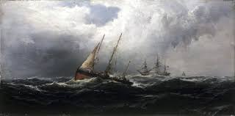
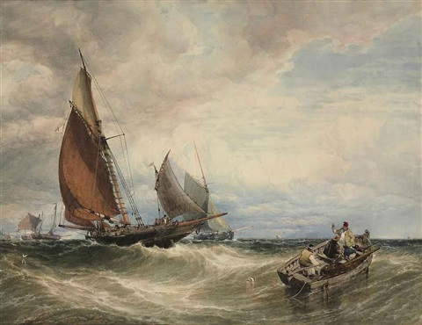
Beginning of the trouble
Second day out of Cape Town they encountered Strong Gales which continued for the next few days.
The narrator was not worried about the gale but the size of the waves; up to 15 meters , as high as the main mast..

Slide 16
DECEMBER 25
Reached 3,500 Kilometer east of Cape Town
Atrocious weather
Despite bad weather had a wonderful holiday with a Christmas tree.
Weather continued to worsen.
WORD MEANING
Atrocious- extremely bad or unpleasant.
despite- in spite of

Slide 17
January 2- The First Calamity
The condition worsened, Waves became gigantic and the Winds were screaming
They were Sailing with only a small jib
They were still making eight knots.
They Faced enormous waves,
To slow the boat, they dropped jib
Went through life-raft drills
Attached life lines, donned oilskins and life jackets.
Waited in apprehension of the approaching storm.
WORD MEANINGS
Gigantic- very great size or extent; huge or enormous
Jib- a triangular staysail set forward of the mast.
life-raft drill – practising how to climb into a lifeboat if the main boat sinks
Knots- a unit of speed equivalent (Km/h: 1.852)
Donned- put on
Oilskins- heavy cotton cloth waterproofed with oil
Apprehension- anxiety or fear that something bad or unpleasant will happen.

Slide 18
IMPENDING DISASTER
The first indication came around 6p.m with ominous silence.
The wind dropped
The sky grew dark
They were approached by a cloud like wave
The thunderous explosion shook the deck
A torrent of green and white water broke over the ship
The author’s head smashed into the wheel
He was flying overboard and sinking below the waves.
He almost lost his consciousness and accepted his approaching death.
WORD MEANINGS
impending- about to happen, approaching
Disaster- a sudden accident or a natural catastrophe that causes great
damage or loss of life.
ominous- threateningly inauspicious.
Torrent- a strong and fast-moving stream of water
Overboard- from a ship into the water.

Slide 19
IMPENDING DISASTER
The Narrator’s head popped out of the water due to the force of the waves.
Wavewalker was near capsizing
Mast was almost horizontal
He saw Wavewalker to be on the verge of overturning when another huge wave turned it upright again.
His life jacket taut.
He grabbed the guard rails of the boat and sailed into the main boom of the boat.
WORD MEANINGS
Capsizing- be overturned in the water.
taut- stretched or pulled tight; not slack.
Rag doll- doll stuffed with torn pieces of cloth

Slide 20
The waves that were pouring inside were so powerful that he got tossed around the deck like a rag doll.
His left ribs cracked.
His teeth were broken.
His mouth was filled with blood.
He somehow found the wheel , lined up the next wave and was fully determined to face the next wave.
There was water all around and the narrator was anxious that it had filled the lower part of the ship.
He did not dare to leave the wheel to examine the damaged parts.

Slide 21
Mary shouted that the decks were broken and they were sinking.
The narrator asked Mary to take charge of the wheel and he rushed outside and saw that Larry and Herb were pumping water out frantically.
A lot of things were floating noisily around because of excessive water.
The narrator was panicky and struggled through water to his children’s cabin to check on them.
WORD MEANINGS
Frantically- in a hurried, excited, or disorganized manner
Panicky- feeling or characterized by uncontrollable fear or anxiety.

Slide 22
CHILDREN ARE SAFE
They were safe and had settled on the upper bunk of the bed.
Sue had a big bump above her eyes, she did no fuss about it.
He left the children's cabin as his chief concern was to save the Wavewalker.
WORD MEANINGS
bunk- a narrow shelf like bed, typically one of two or more arranged one on top of the other.
Fuss- a display of unnecessary or excessive excitement, activity, or interest.
Cabin- a private room or compartment on a ship.

Slide 23
The starboard side was struck open because of which they were taking more water.
He realised that if he did not make some repairs urgently, the boat would sink.
He managed to cover the gaping holes with canvas and waterproof hatched covers.
He could finally prevent the water from seeping in.
WORD MEANINGS
gaping- wide open

Slide 24
THE HAND PUMPS
The hand pumps started to block up with the debris floating around.
The electric pump short circuited and the water level rose threateningly.
The spare hand pumps had wrenched over board along forestay sail, the jib, the dinghies and the main anchor from the deck.
He was lucky enough to get two more working electric pumps.
WORD MEANINGS
Debris- scattered pieces of rubbish or remains.
Wrenched- removed and thrown from where they were fixed
Forestay- a rope to support a ship's foremast, running from its top to the deck at the bow.
Dinghies- a small boat especially an open boat with a mast and sails.

Slide 25
They tried to get connected to Mayday Calls, but all in vain because they were far away from the mainland. (remote corner of the world)
A Mayday call is a distress signal used during emergency procedures. It indicates life-threatening emergency especially by aviators and mariners.

Slide 26
The Courageous Sue
Sue’s head had swollen alarmingly.
She had two enormous black eyes.
She also had a deep cut on her arm.
She didn’t inform her parents about her injury as she knew that her father was attending to the more serious issue; saving Wavewalker and the life of all on board.

Slide 27
THANK YOU

